Slide 1
Encryption of Future (Quantum Cryptography)
Heekwan Yang
Encryption
ITMS 528,
October 21,2015
Notes:
양자 암호화 미래의

Slide 2
Cryptography.
Transmitting information with access restricted to the intended recipient.
Cryptography is increasing importance
in our technological age transmitting sensitive information.
Notes:
방해 받더라도 의도된 수신자에게 정보를 전송하는것!
암호학더 중요해 지고 있다 민감한 정보가 있고 여러분야에 연관되어 있음

Slide 3
The process
Plaintext
Key
Sender
Encryption
Cryptotext
Secure
transmission
Decryption
Recipient
Plaintext
Key ready for use
Message encryption
Secure key distribution
Hard Problem for conventional
encryption
Notes:
절차는 오른쪽 키는 보안화 시킴 . 사용준비완료
이것은 전통적인 암호화이다!

Slide 4
The classic cryptography
Encryption algorithm and related key are kept secret.
Breaking the system is hard due to large numbers of possible keys.
there are
keys to check using brute force.
The fundamental difficulty is key distribution to people
who want to exchange messages.
Notes:
고전암호화 에 대해 키에 관련되어 있다

Slide 5
PKC :the modern cryptography
In 1970s the Public Key Cryptography emerged.
Each user has two mutually inverse keys,
The encryption key is published;
The decryption key is kept secret.
Anybody can send a message to Bob
but only Bob can read it.

Slide 6
RSA
The most widely used PKC is the RSA algorithm
Easy Problem Hard Problem
Given two large
primes p and q
compute
Given n
compute p and q.

Slide 7
Factoring a product of two large primes
For p & q 65 digits long T(n) is approximately
one month using cluster of workstations.
For p&q 200 digits long T(n) is astronomical.

Slide 8
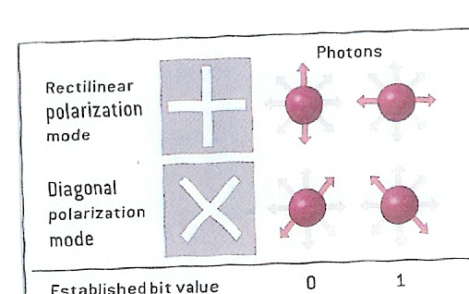
Elements of the Quantum Theory
Notes:
양자의 분극화

Slide 9
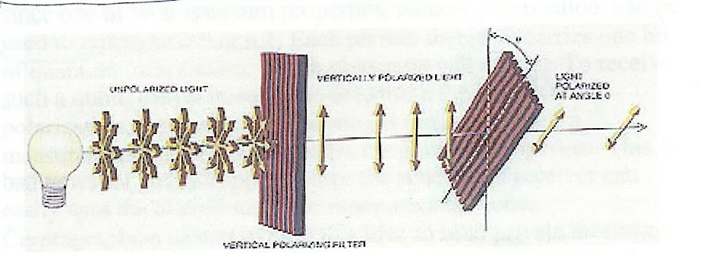
Photon Polarization
Vertical filter
Tilted filter at
the angle

Slide 10
Polarization by a filter
A pair of filters such as vertical/horizontal is called a basis.
the measurement in the first basis completely randomizes the measurements in the second basis.
Notes:
Conjugate 활용하다

Slide 11
Binary information
Each photon carries one qubit of information
Polarization can be used to represent a 0 or 1.
To determine photon’s polarization, the recipient must measure the polarization by ,for example, passing it through a filter.

Slide 12
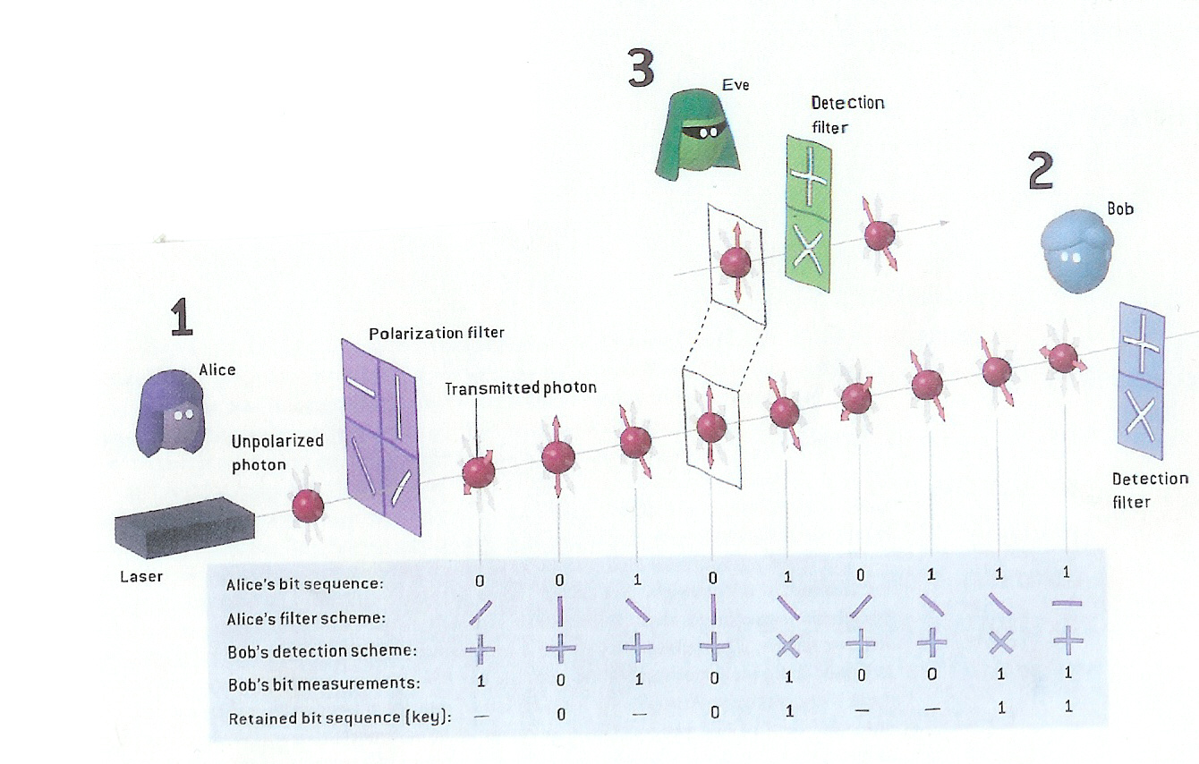
Example of key distribution

Slide 13
Quantum key distribution
Both Alice and Bob have two polarizers each.
One with the 0-90 degree basis (+) and one with 45-135 degree basis ( )
Bob uses his polarizers to measure each
polarization of photons he receives.

Slide 14
Example of key distribution

Slide 15
Noise
The presence of noise can impact detecting attacks.
Eavesdropper and noise on the quantum channel are indistinguishable.
Detecting eavesdropper in the presence of noise is hard.

Slide 16
Security of quantum key distribution
Quantum cryptography obtains its fundamental security from the fact that each qubit is carried by a single photon, and each photon will be altered as soon as it is read.
This makes impossible to intercept message without being detected.

Slide 17
The Main contribution of Quantum Cryptography.
It solved the key distribution problem.
Unconditionally secure key distribution method proposed by:
Charles Bennett and Gilles Brassard in 1984.
The method is called BB84.
Once key is securely received, it can be used to encrypt messages.

Slide 18
State of the Quantum Cryptography technology.
Experimental implementations have existed since 1990.
Current QC is performed over distances of 148.7 kilometers using optical fiber.
In general we need two capabilities.
Single photon gun.
(2) Being able to measure single photons.

